Slide 1
Term Project---
Cassava Leaf Disease Classification
(木薯葉病分類)
2024/05/31
組員:余秉諺 (學號:112321523)
吳承翰 (學號:112356502)

Slide 2
Introduction
Datasets
Data Processing
Models
Results
Conclusion

Slide 3
Introduction
In this competition, we introduce a dataset of 21,367 labeled images collected during a regular survey in Uganda. Most images were crowdsourced from farmers taking photos of their gardens, and annotated by experts at the National Crops Resources Research Institute (NaCRRI) in collaboration with the AI lab at Makerere University, Kampala. This is in a format that most realistically represents what farmers would need to diagnose in real life.
Your task is to classify each cassava image into four disease categories or a fifth category indicating a healthy leaf. With your help, farmers may be able to quickly identify diseased plants, potentially saving their crops before they inflict irreparable damage.

Slide 4
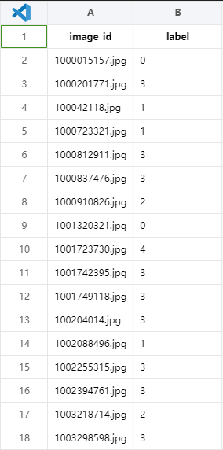
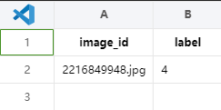
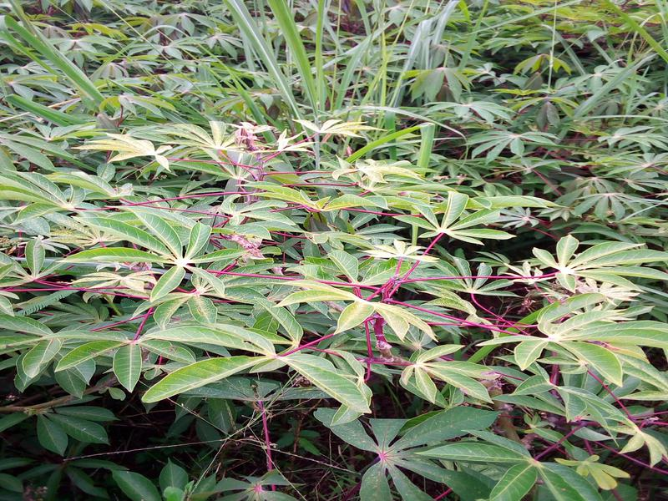
Datasets
Train.csv
Submission.csv

Slide 5
Datasets - labels
label | class | Quantity
Class_0 | Cassava Bacterial Blight (CBB-木薯白葉枯病) | 1087
Class_1 | Cassava Brown Streak Disease (CBSD-木薯褐條病) | 2189
Class_2 | Cassava Green Mottle (CGM-木薯綠斑 ) | 2386
Class_3 | Cassava Mosaic Disease (CMD-木薯花葉病) | 13158
Class_4 | Healthy | 2577
Total |  | 21397

Slide 6
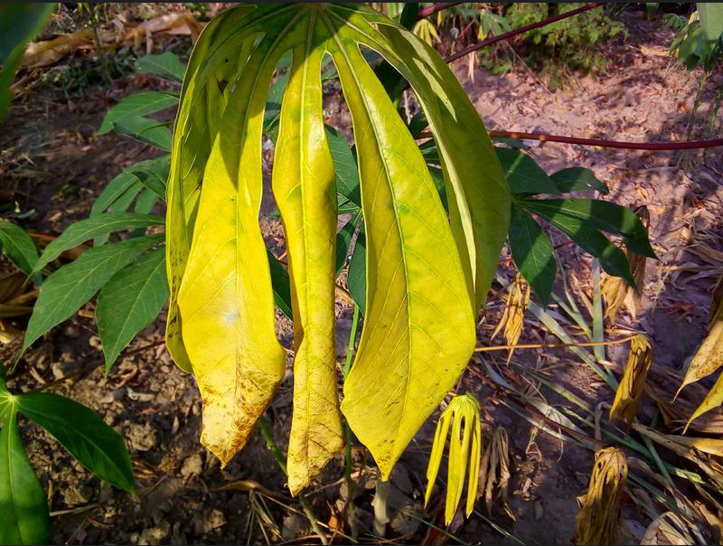
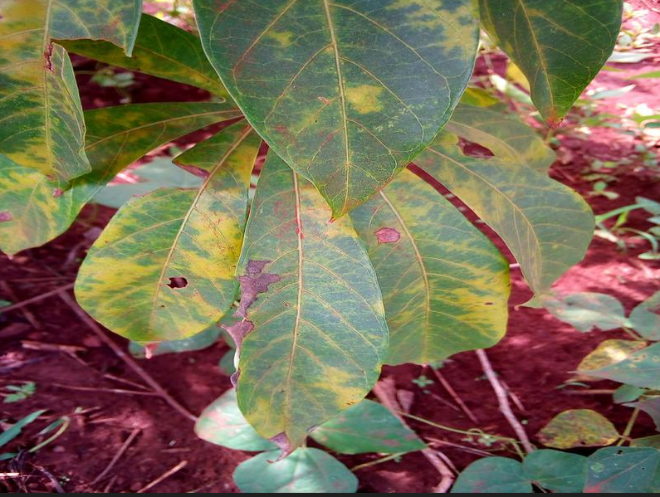
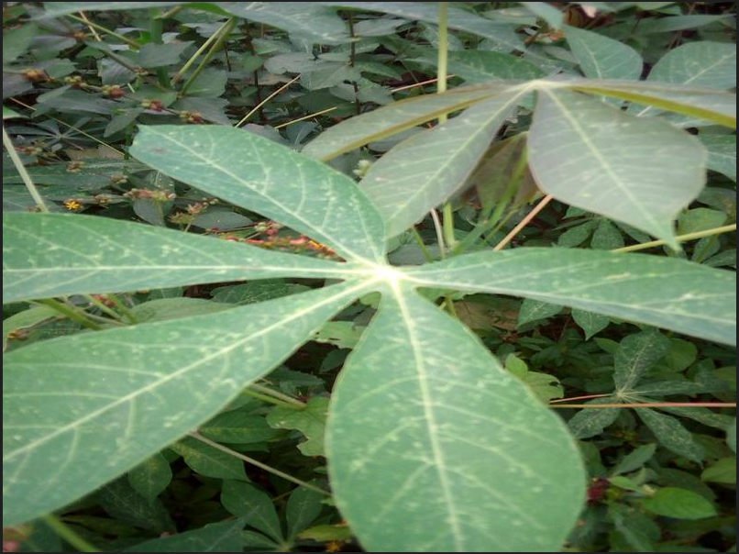
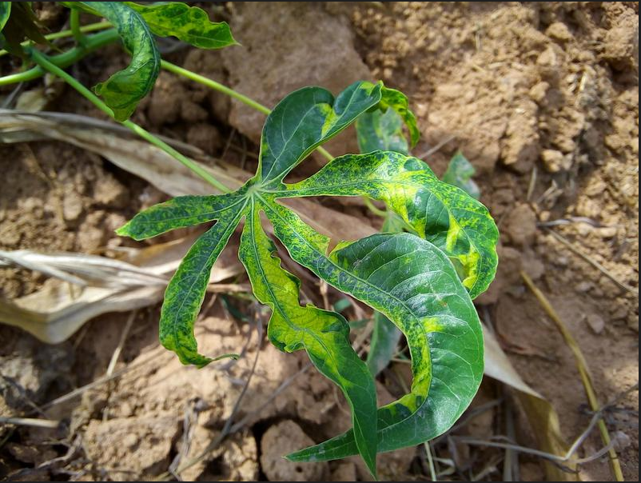
Class
Label:0 Cassava Bacterial Blight (CBB-木薯白葉枯病)
Label:1 Cassava Brown Streak Disease (CBSD-木薯褐條病)
Label:2 Cassava Green Mottle (CGM-木薯綠斑 )
Label:3 Cassava Mosaic Disease (CMD-木薯花葉病)

Slide 7
Dataset - split
Dataset_1 – Random augmentation
Training dataset：17117
Validation dataset：2140
Test dataset：2140
Dataset_2 -Augmentation
Training dataset：205411
Validation dataset：25676
Test dataset：25677

Slide 8
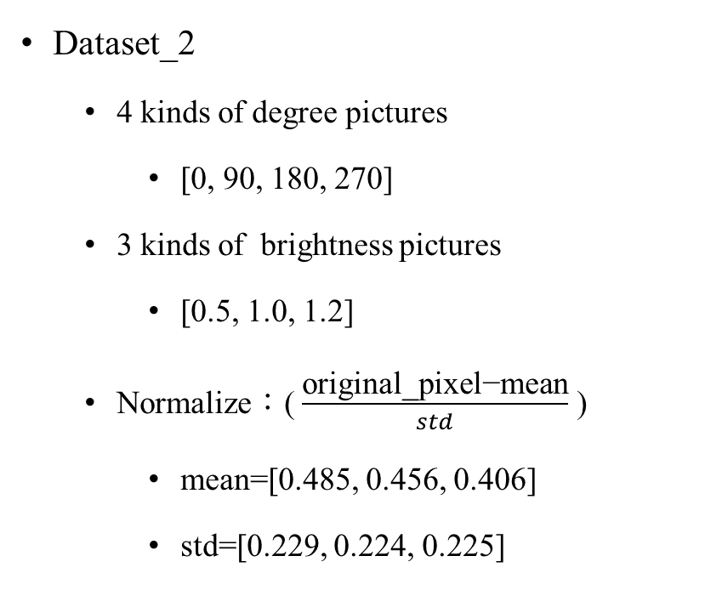
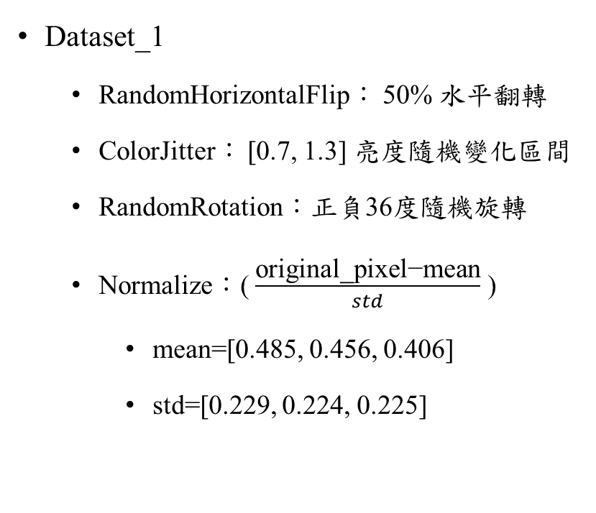
Data Processing - Dataloader
Dataset_1
RandomHorizontalFlip： 50% 水平翻轉
ColorJitter： [0.7, 1.3] 亮度隨機變化區間
RandomRotation：正負36度隨機旋轉
Normalize：( $\frac{\text{original}\text{_}\text{pixel}\text{−}\text{mean}\text{​}}{std}$ )
mean=[0.485, 0.456, 0.406]
std=[0.229, 0.224, 0.225]
Dataset_2
4 kinds of degree pictures
[0, 90, 180, 270]
3 kinds of brightness pictures
[0.5, 1.0, 1.2]
Normalize：( $\frac{\text{original}\text{_}\text{pixel}\text{−}\text{mean}\text{​}}{std}$ )
mean=[0.485, 0.456, 0.406]
std=[0.229, 0.224, 0.225]

Slide 9
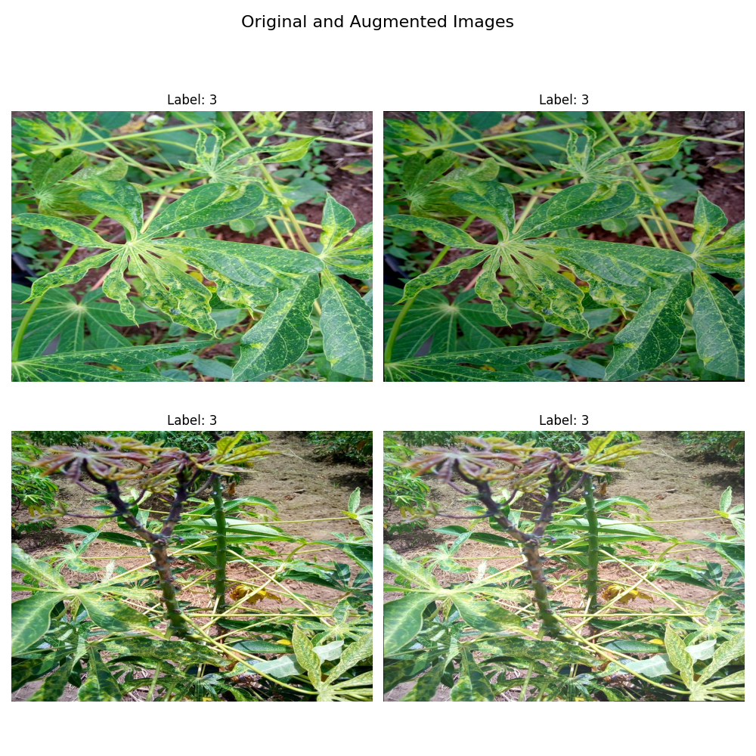
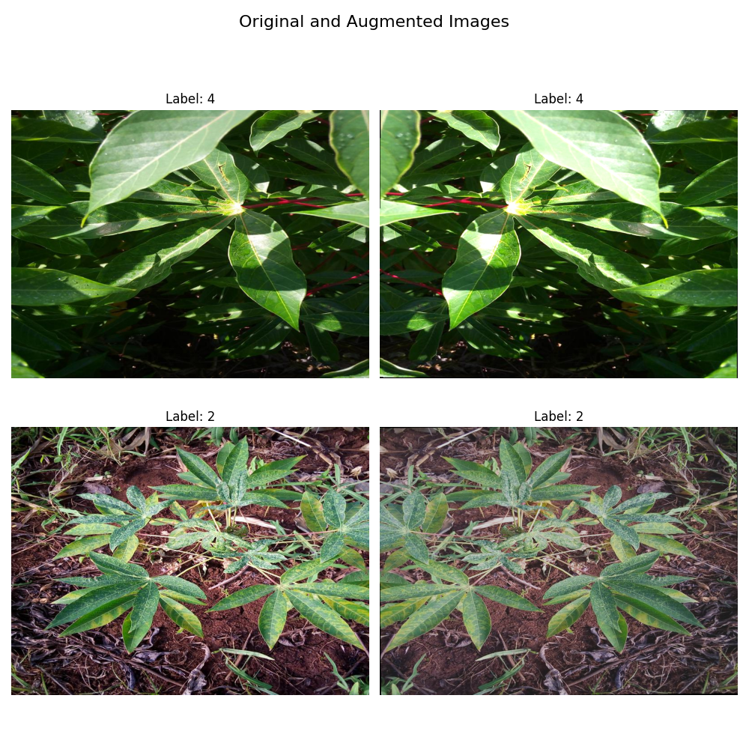
Data Processing

Slide 10
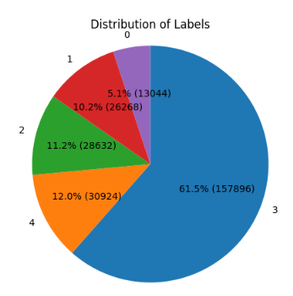
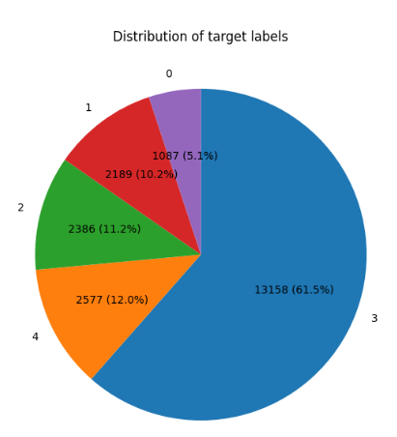
Data Processing - Analyze
Dataset_1
Dataset_2

Slide 11
Data Processing - class_weights
Use class_weights makes data balance
Labels | Weights
0:Cassava Bacterial Blight (CBB) | 19.684810733109728
1:Cassava Brown Streak Disease (CBSD) | 9.774959550775673
2:Cassava Green Mottle (CGM) | 8.967563083908146
3:Cassava Mosaic Disease (CMD) | 1.6261548326828534
4:Healthy | 8.303124621043697

Slide 12
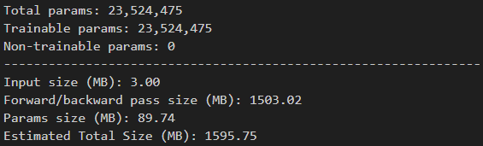
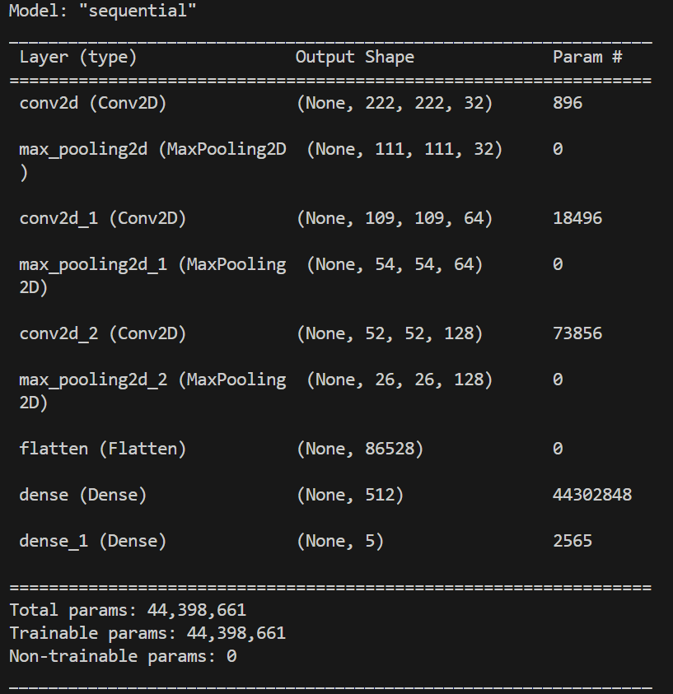
Model – ResNet50
ResNet50
CNN

Slide 13
Results – ResNet50
Train Accuracy: 0.9474
Validation Accuracy: 0.8666
Dataset_2
Train Accuracy: 0.9872
Validation Accuracy: 0.9815
Dataset_1
Test Accuracy: 0.8363
Test Accuracy: 0.9800

Slide 14
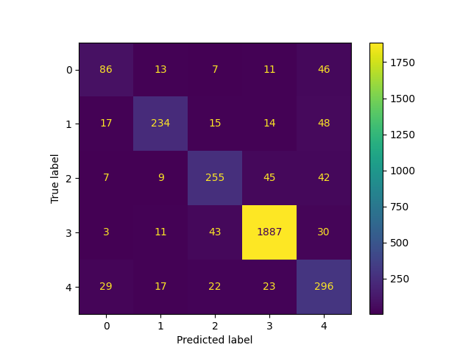
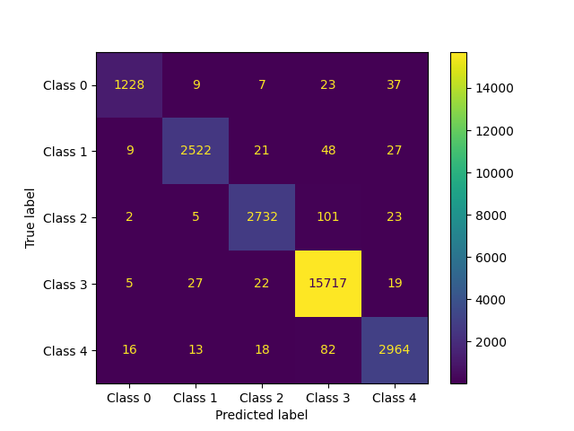
Results – confusion matrix
Dataset_1
Dataset_2

Slide 15
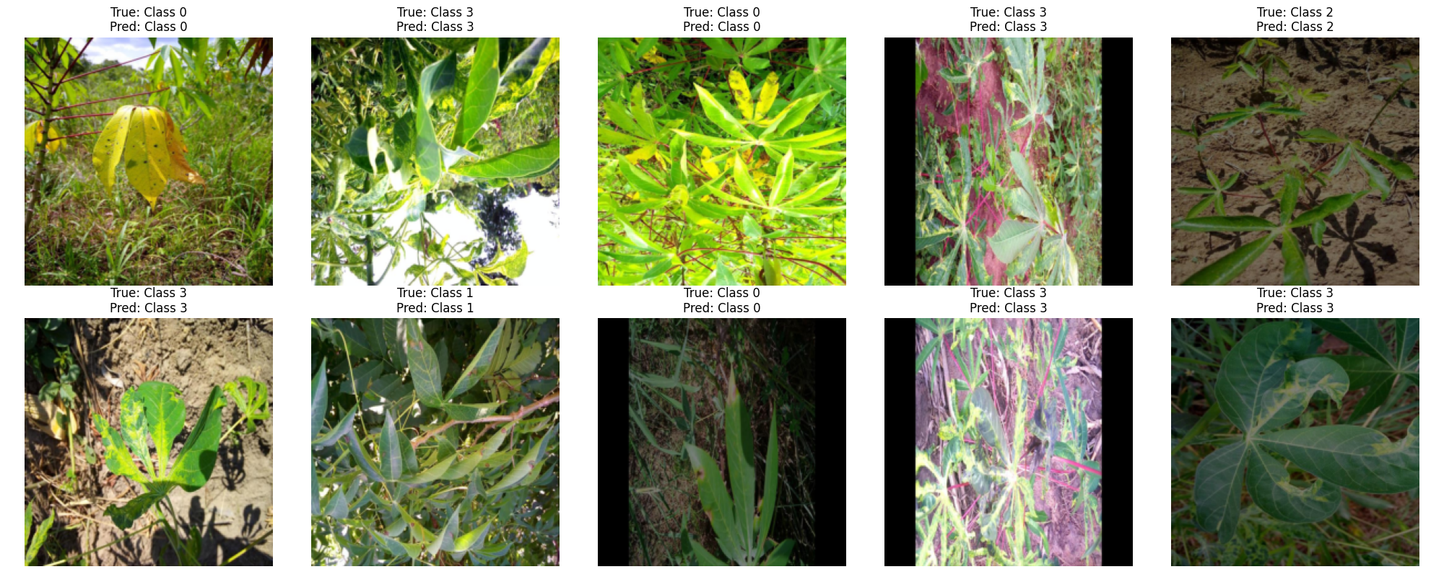
Results

Slide 16
Conclusion
In conclusion, we found that using ResNet50 and training the model with all possible angles and environments produced better results. Simply augmenting data randomly might lead to insufficient diversity in the model's observations, potentially causing prediction errors during the final testing phase. The above is the conclusion of our semester project.

Slide 17
